Slide 1
Operators
Prof. Vishnu Priya P M

Slide 2
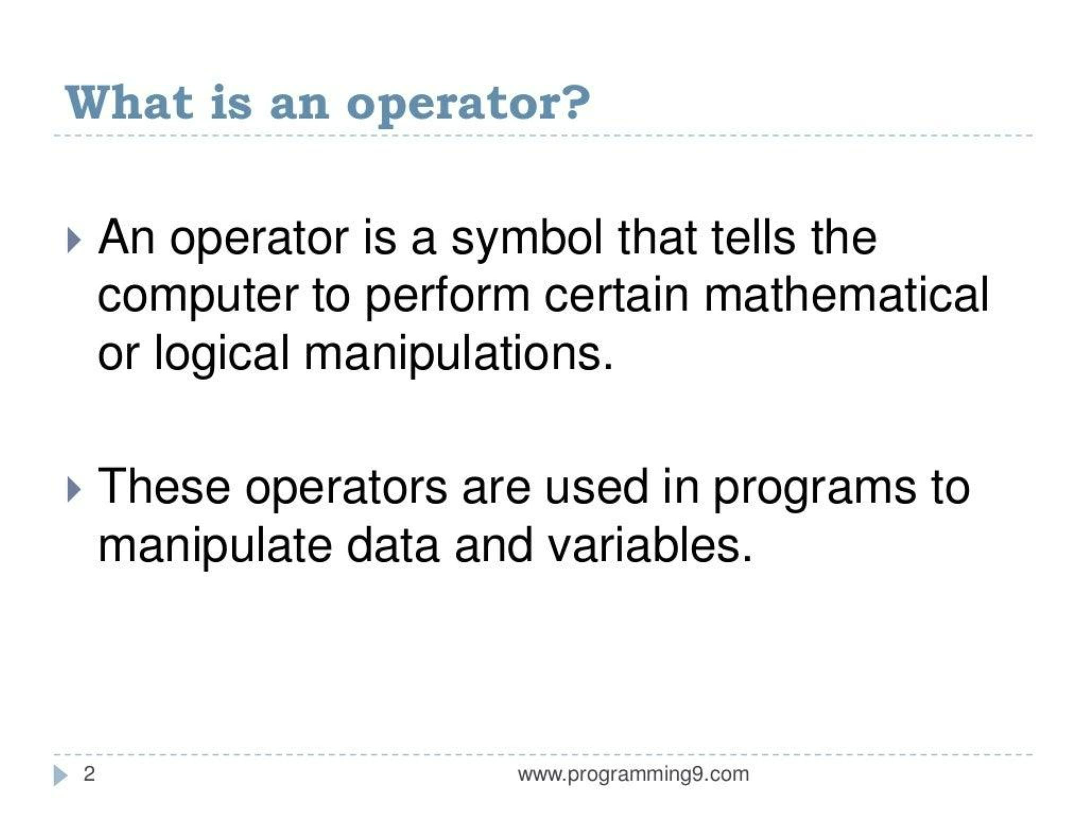

Slide 3
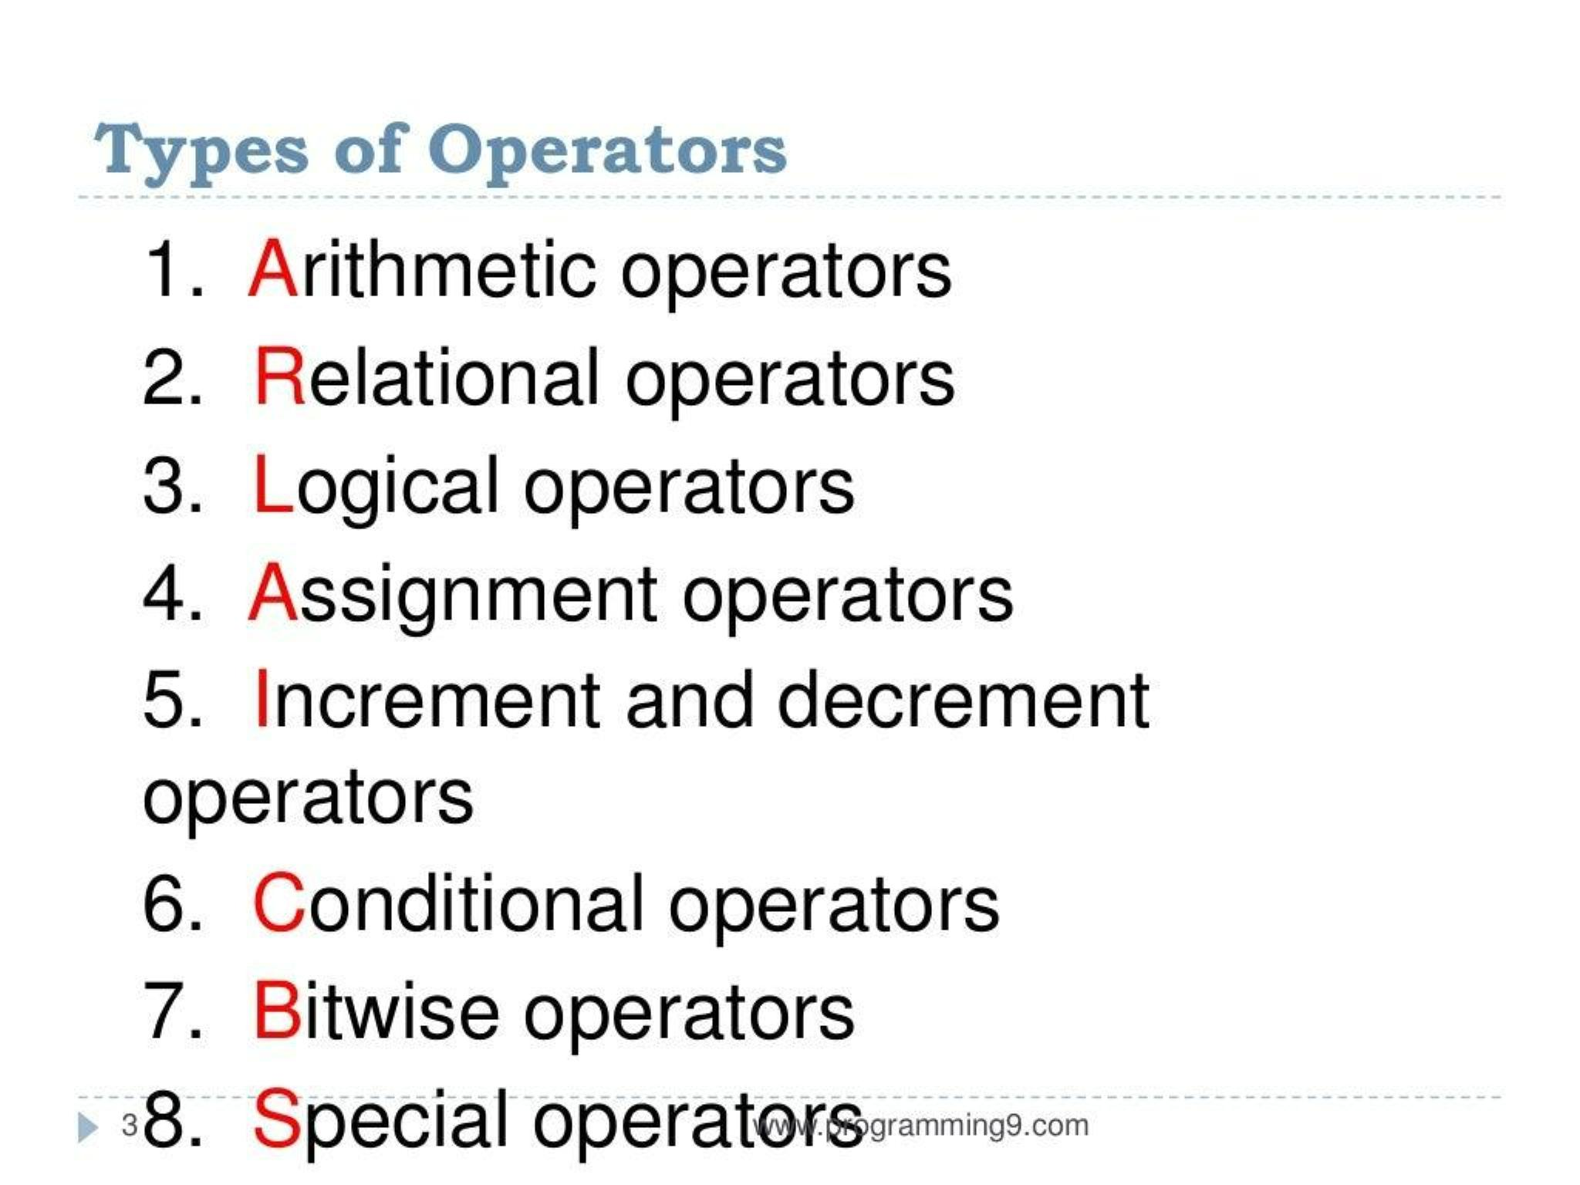
8 . Special Operators

Slide 4
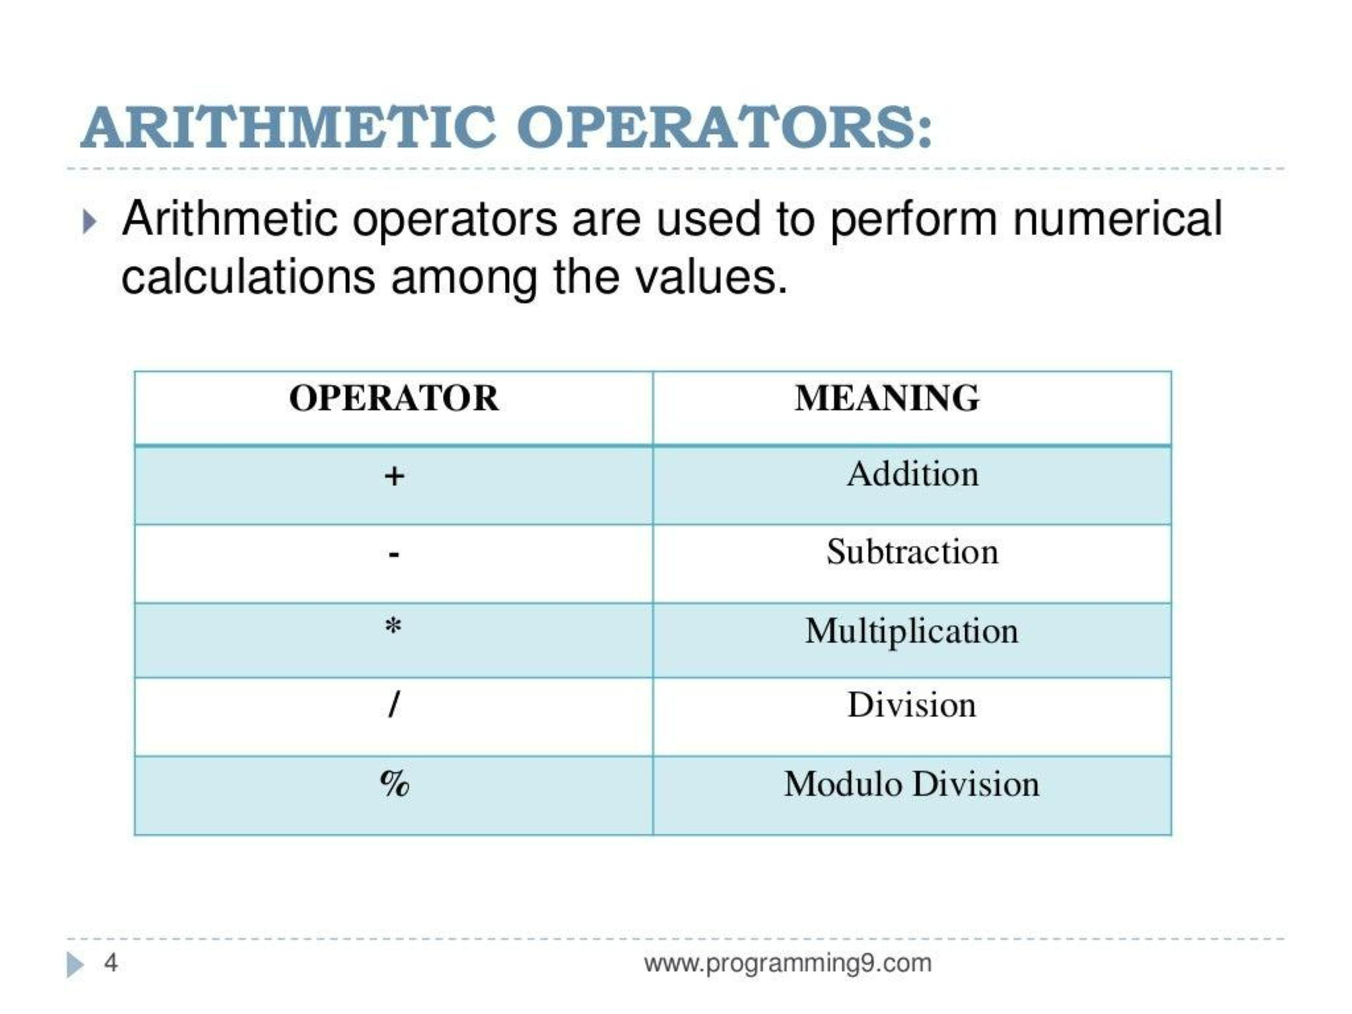

Slide 5
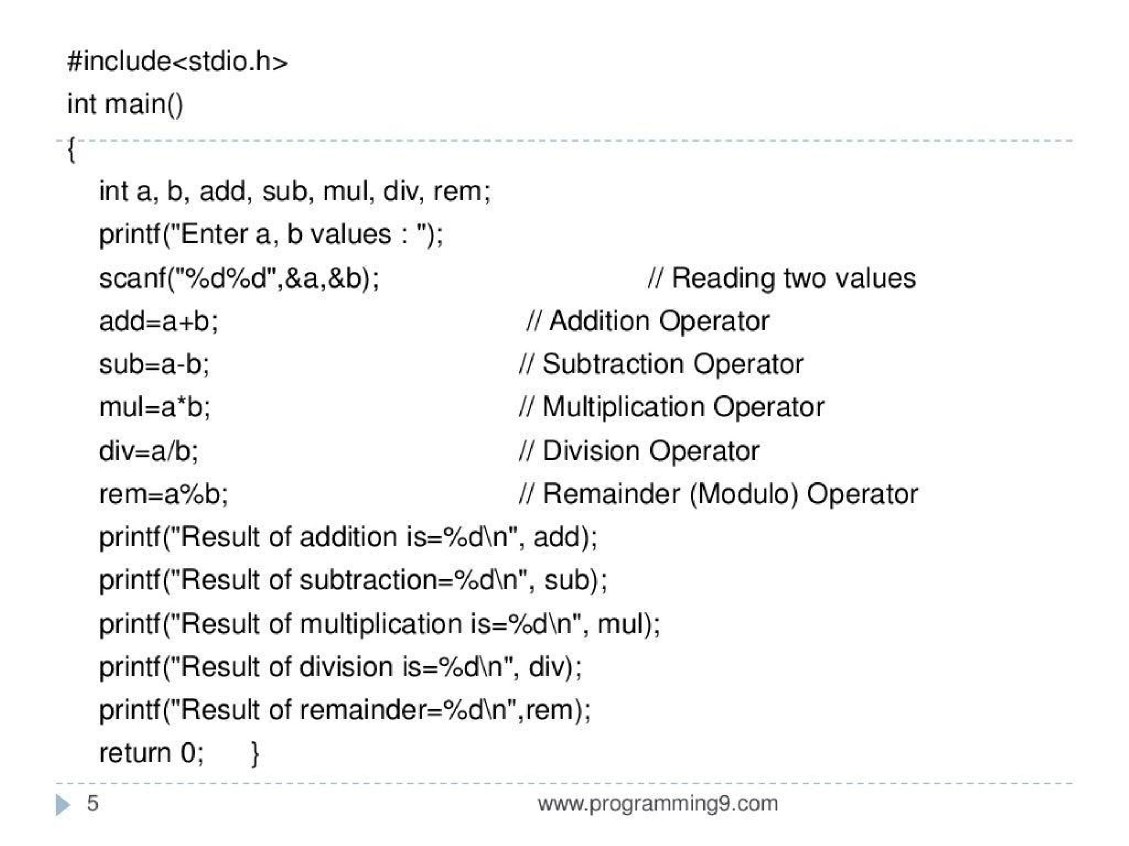

Slide 6
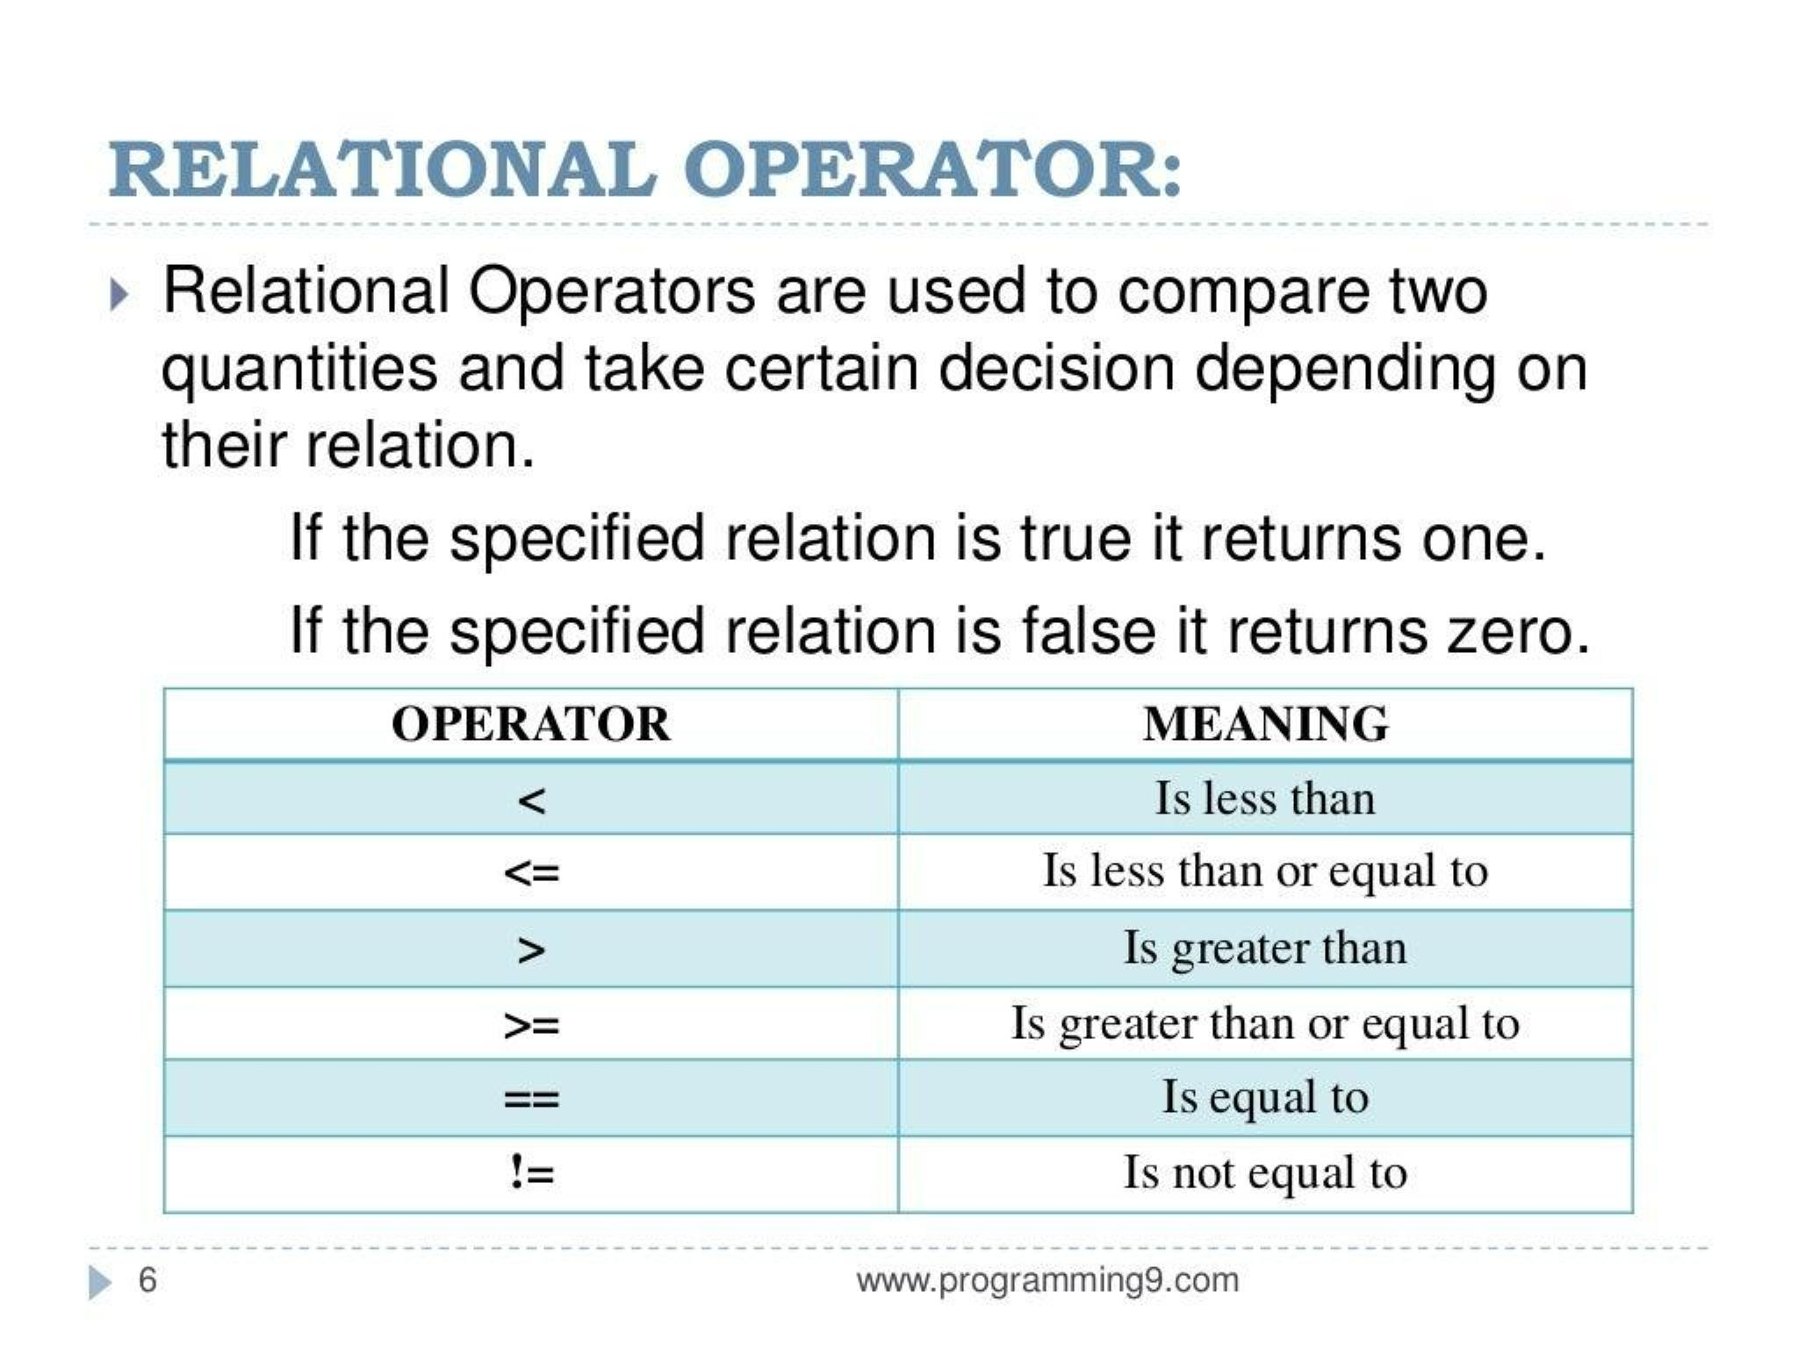

Slide 7
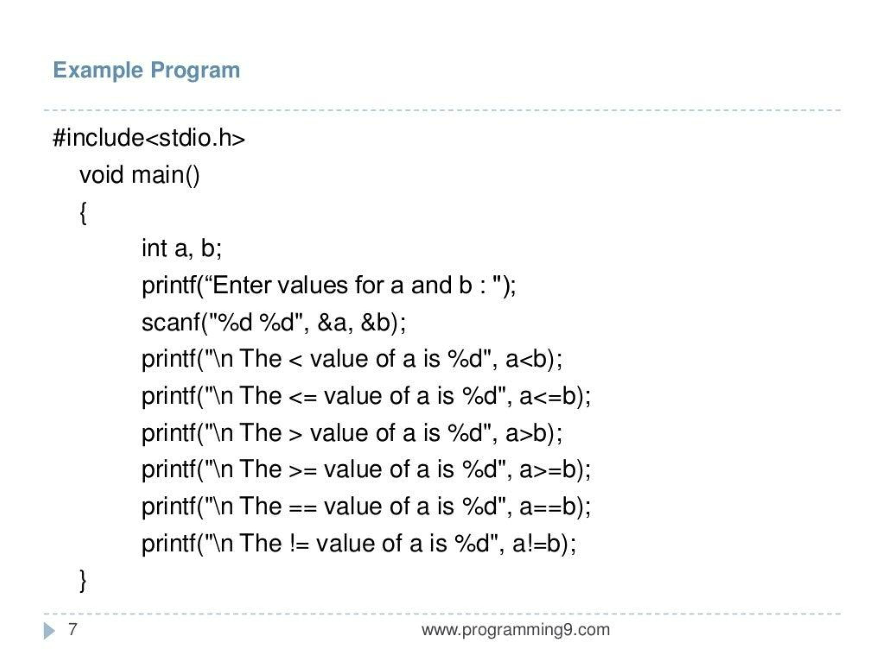

Slide 8
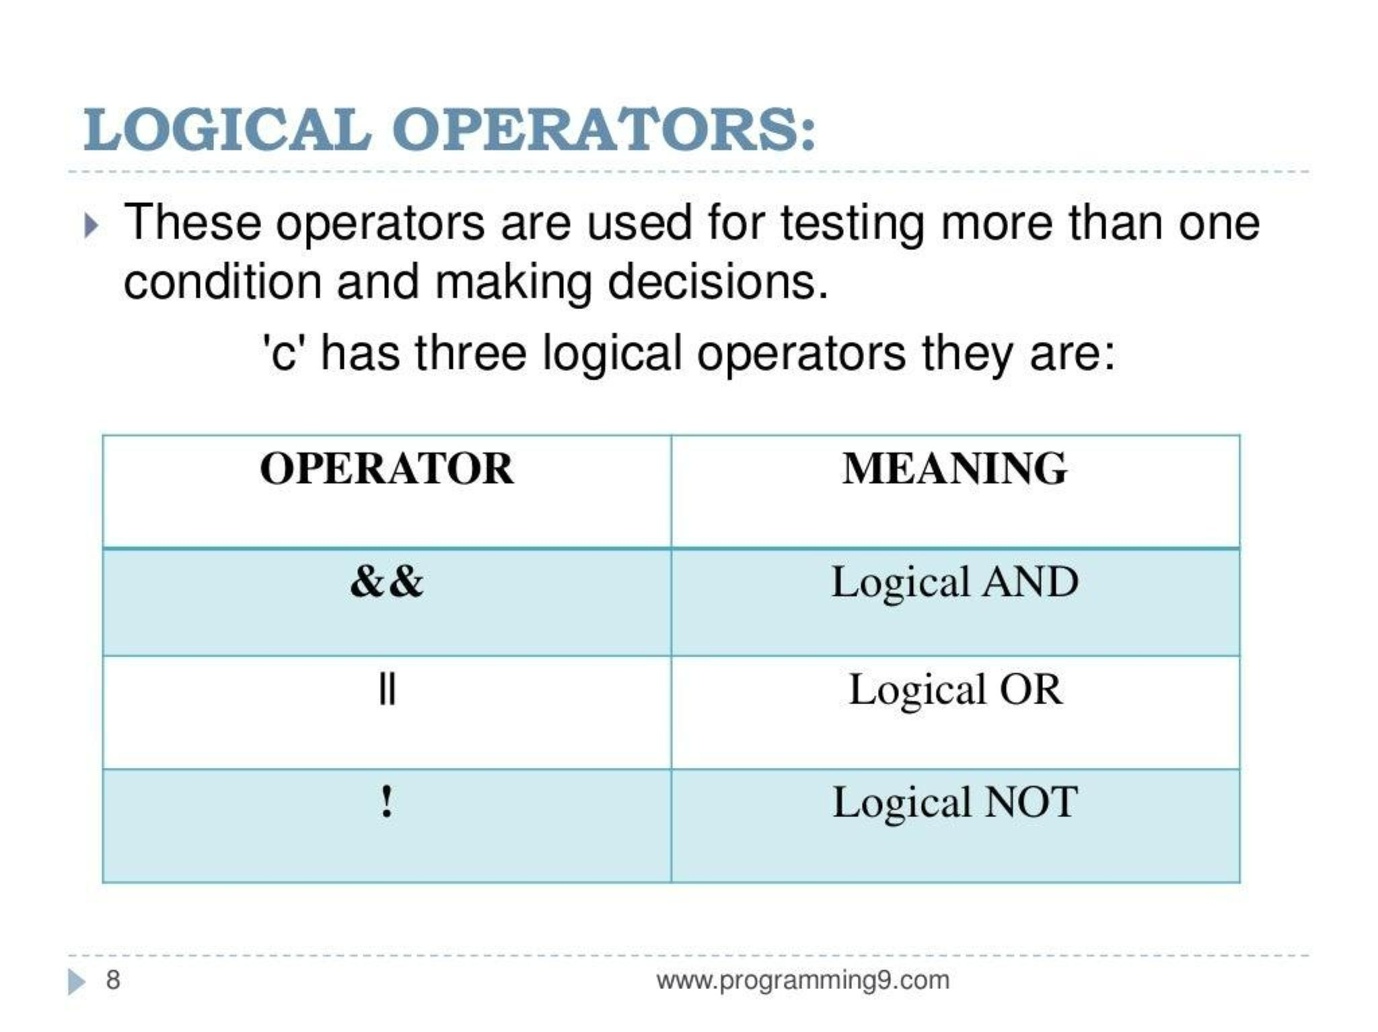

Slide 9
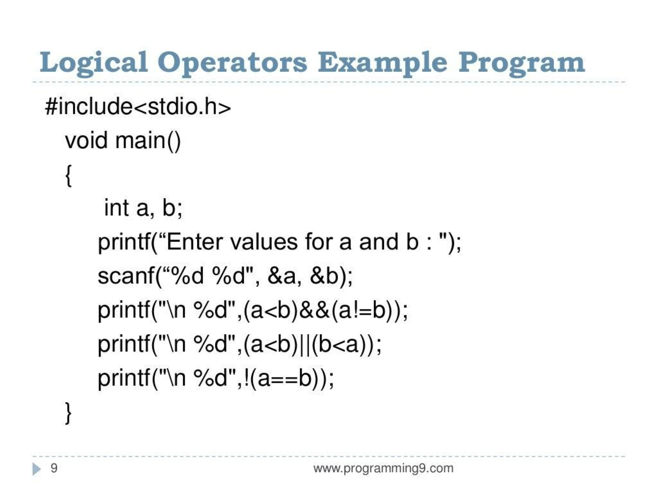

Slide 10
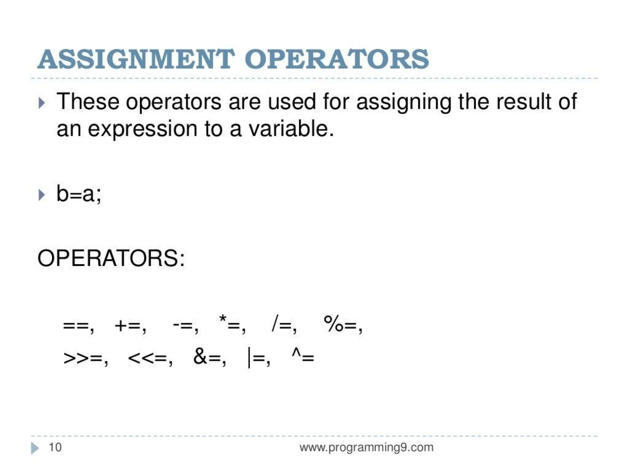

Slide 11
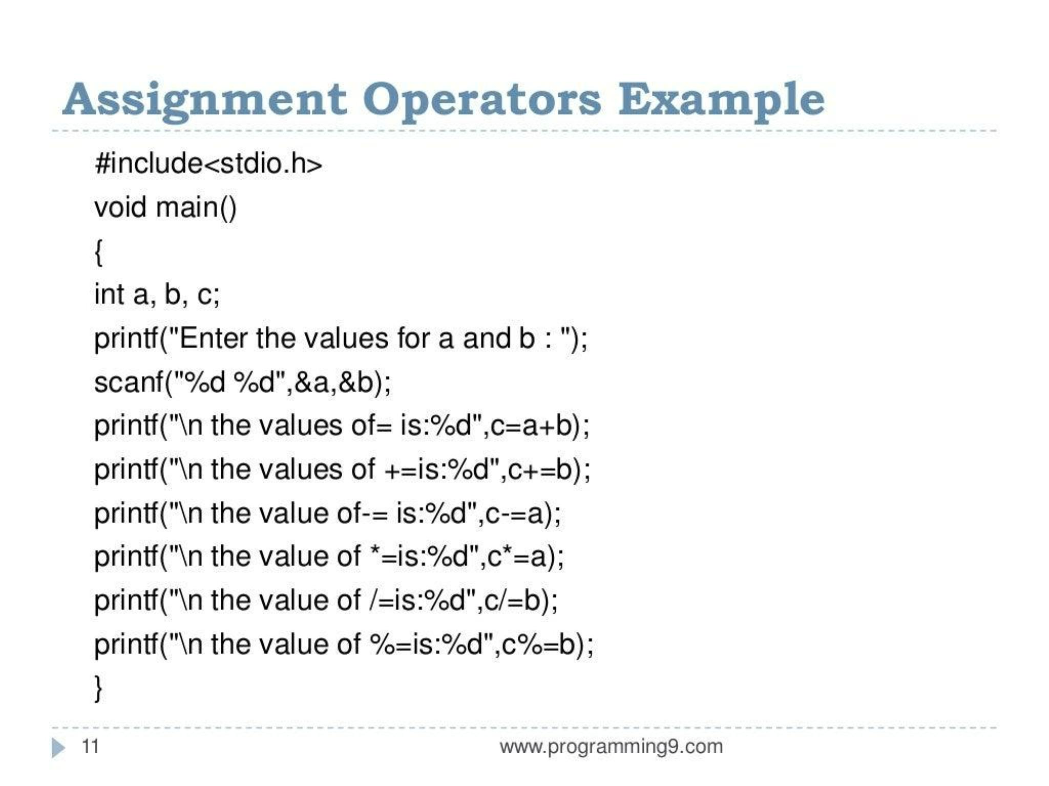

Slide 12
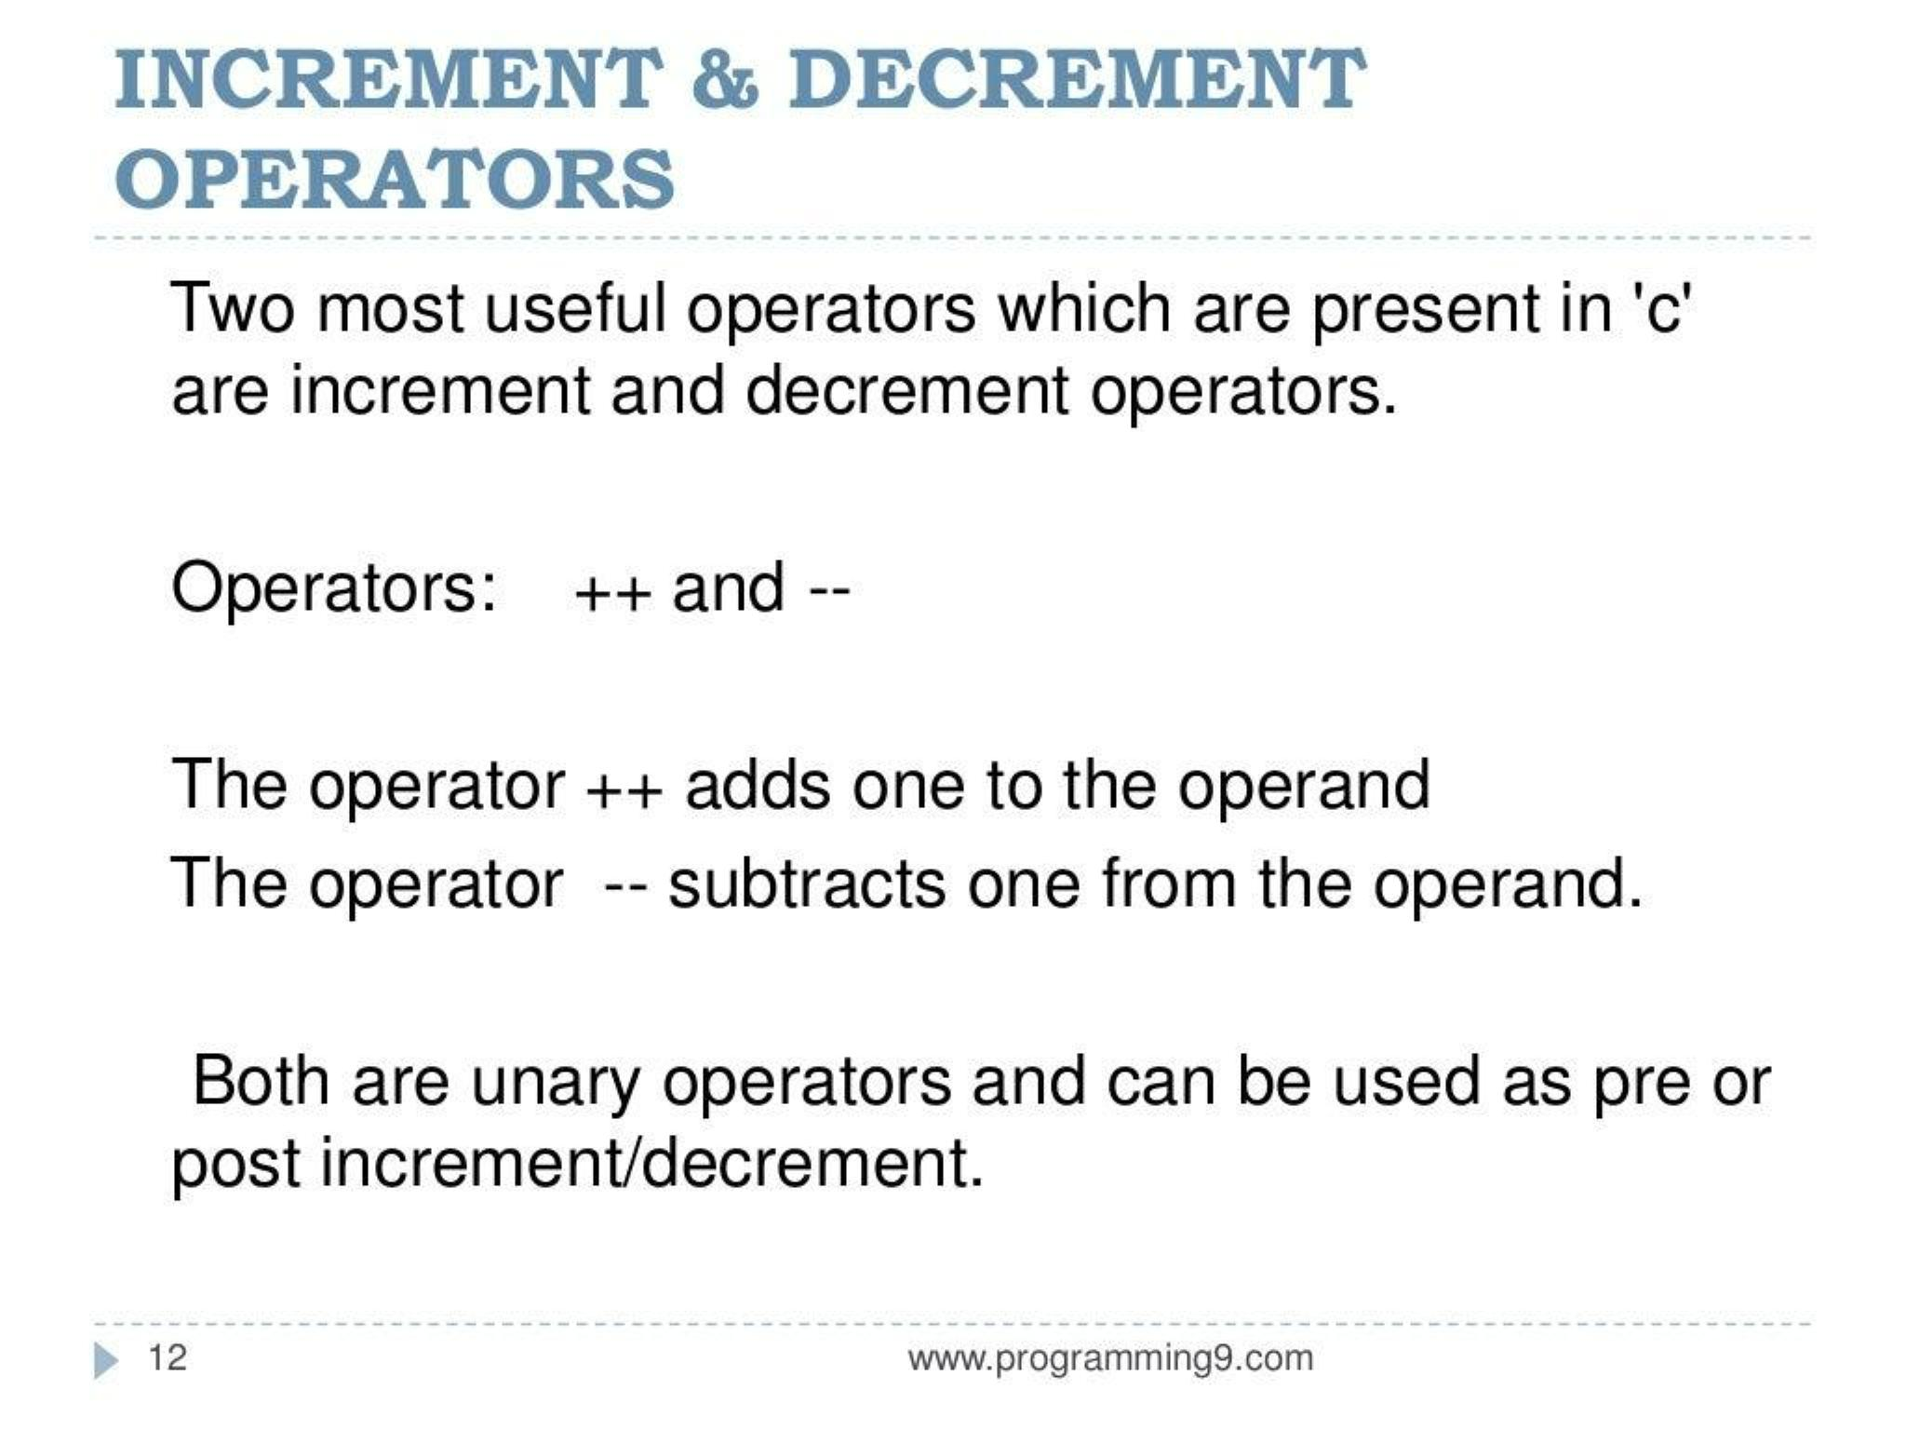

Slide 13
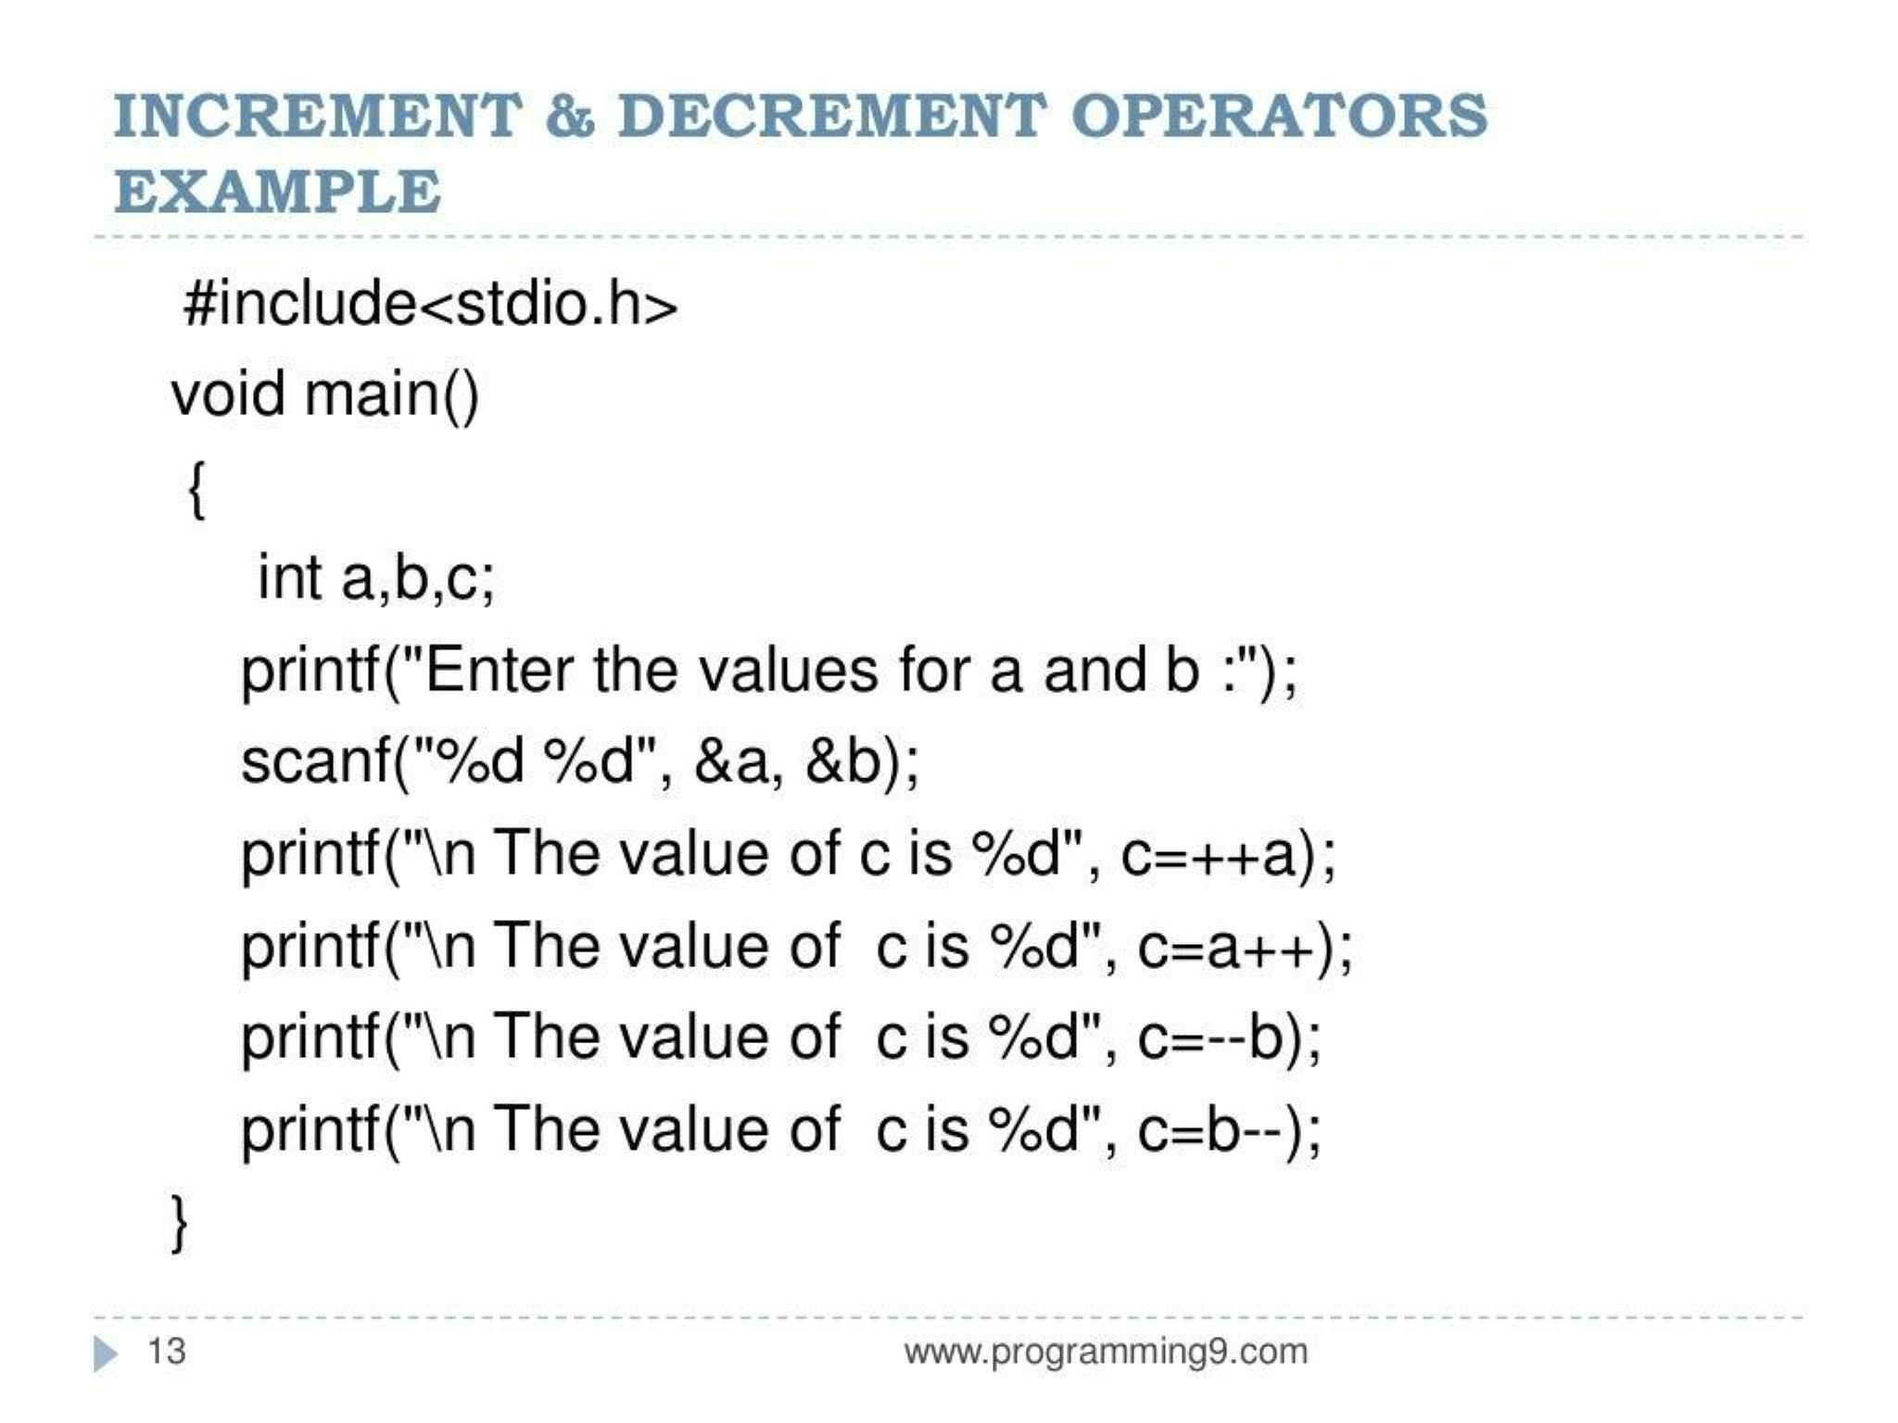

Slide 14
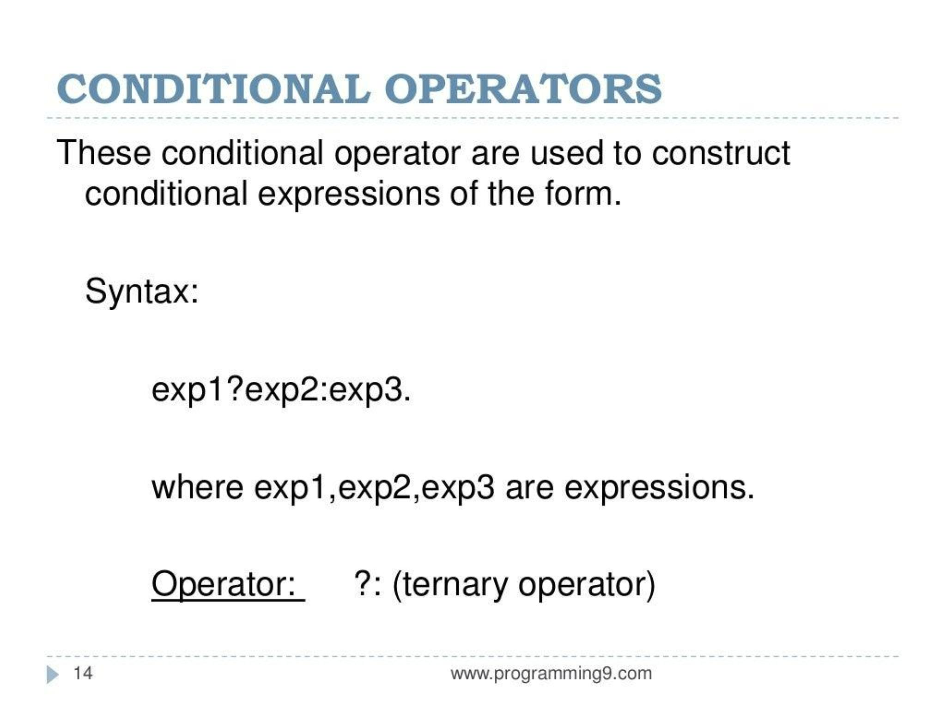

Slide 15
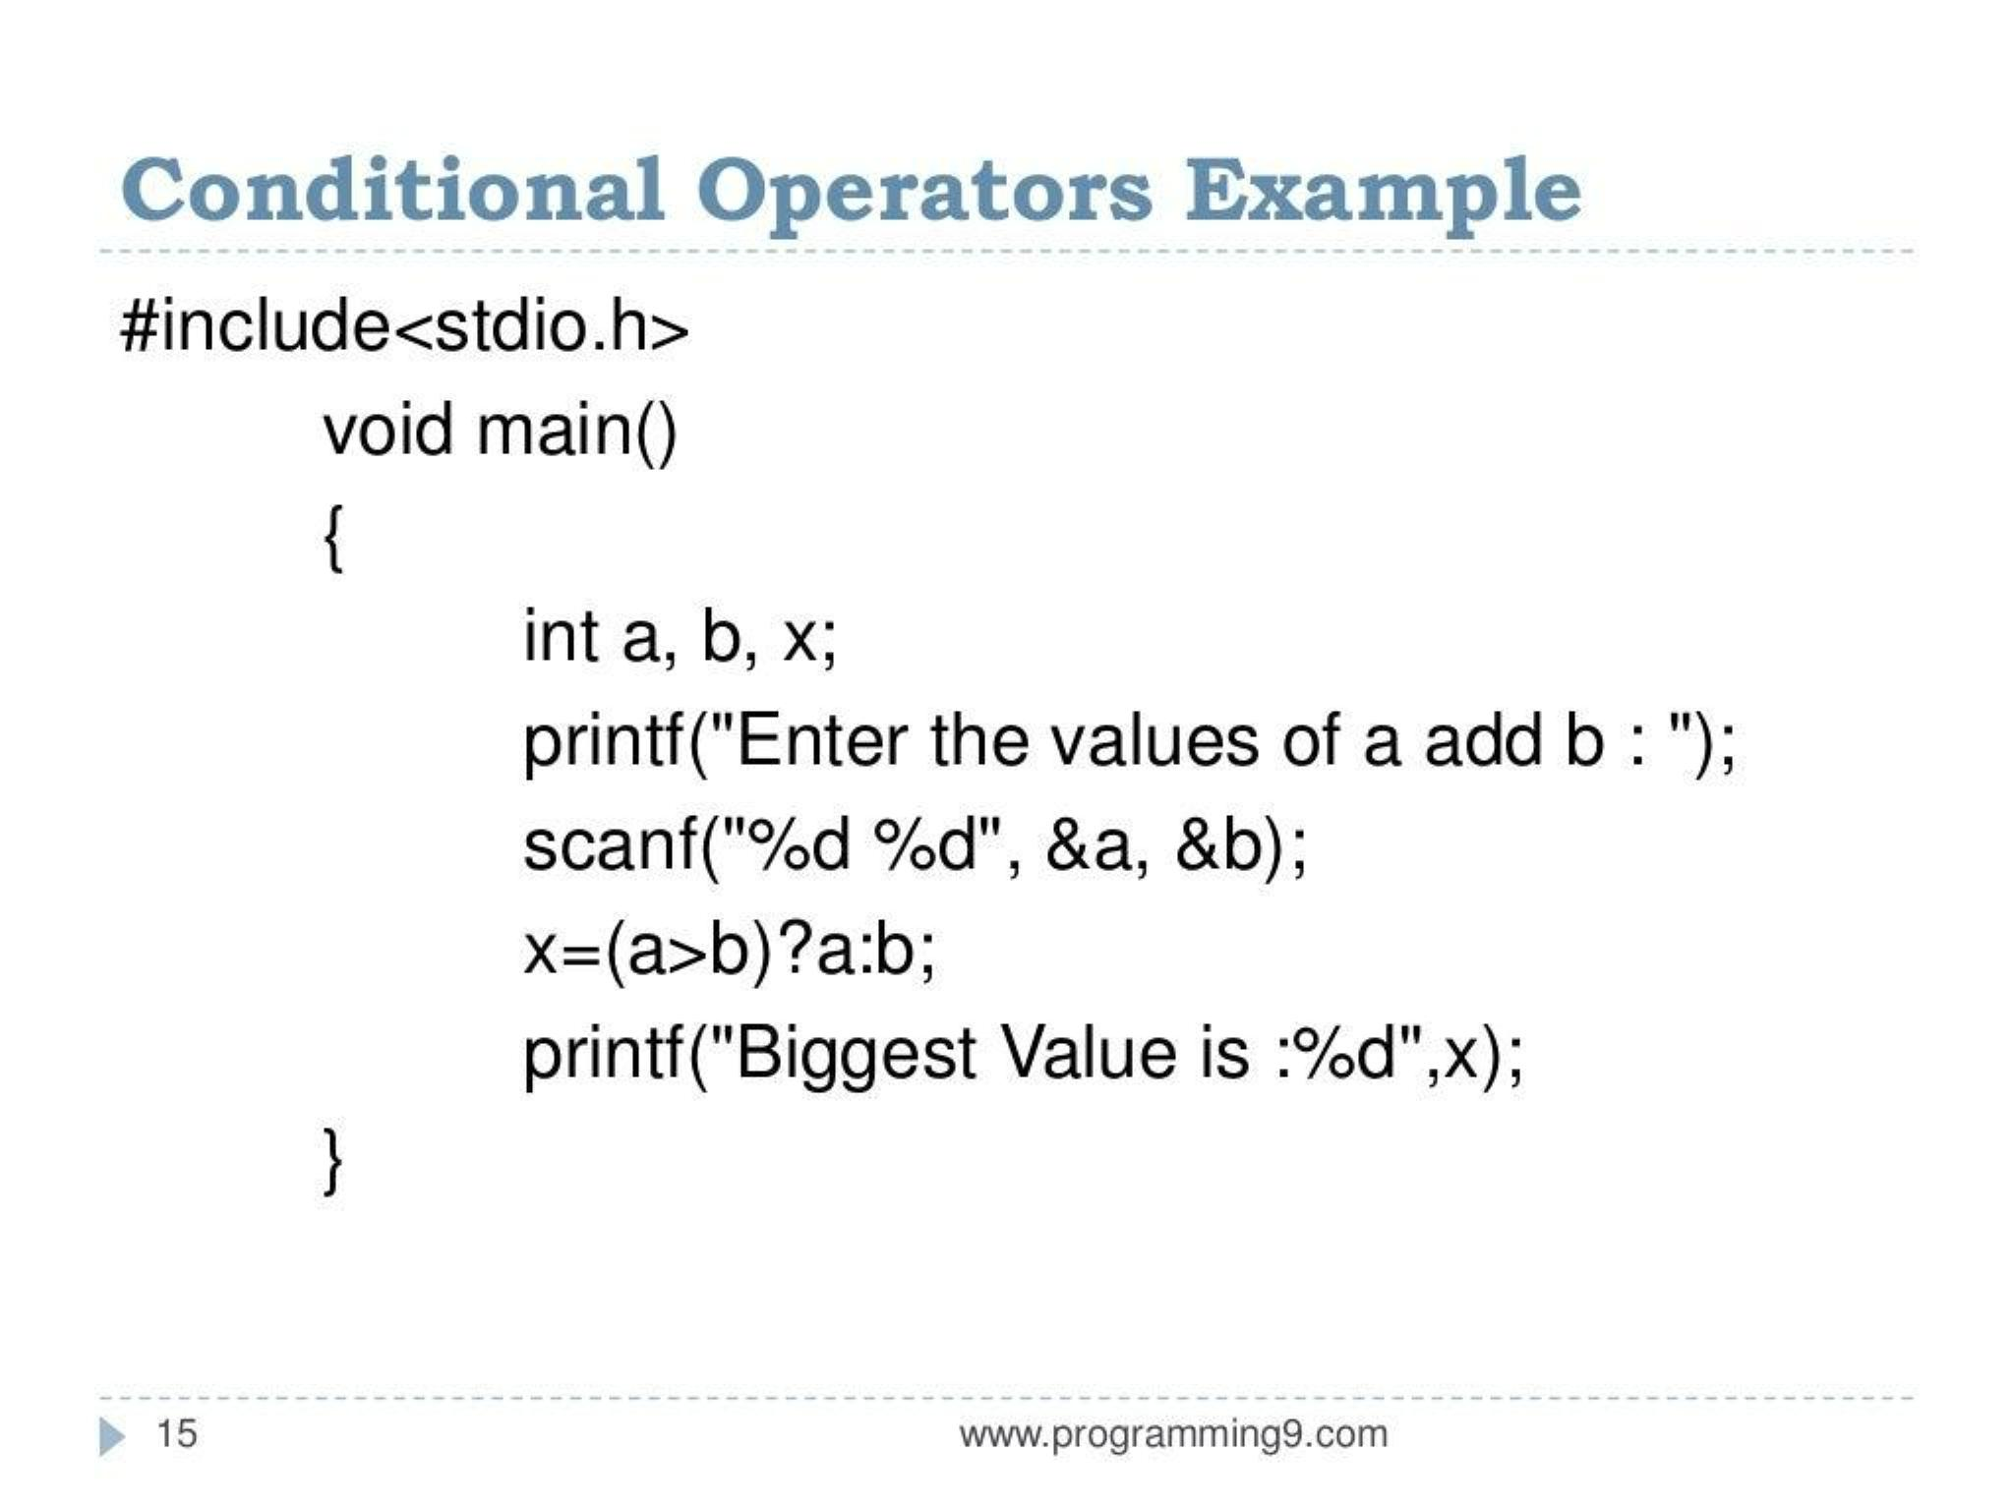

Slide 16
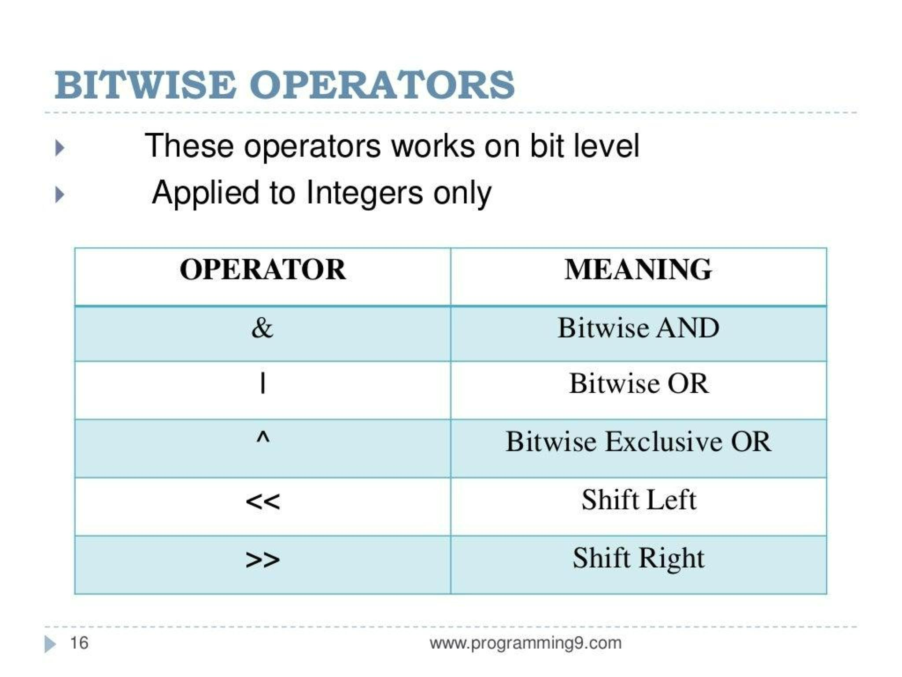

Slide 17
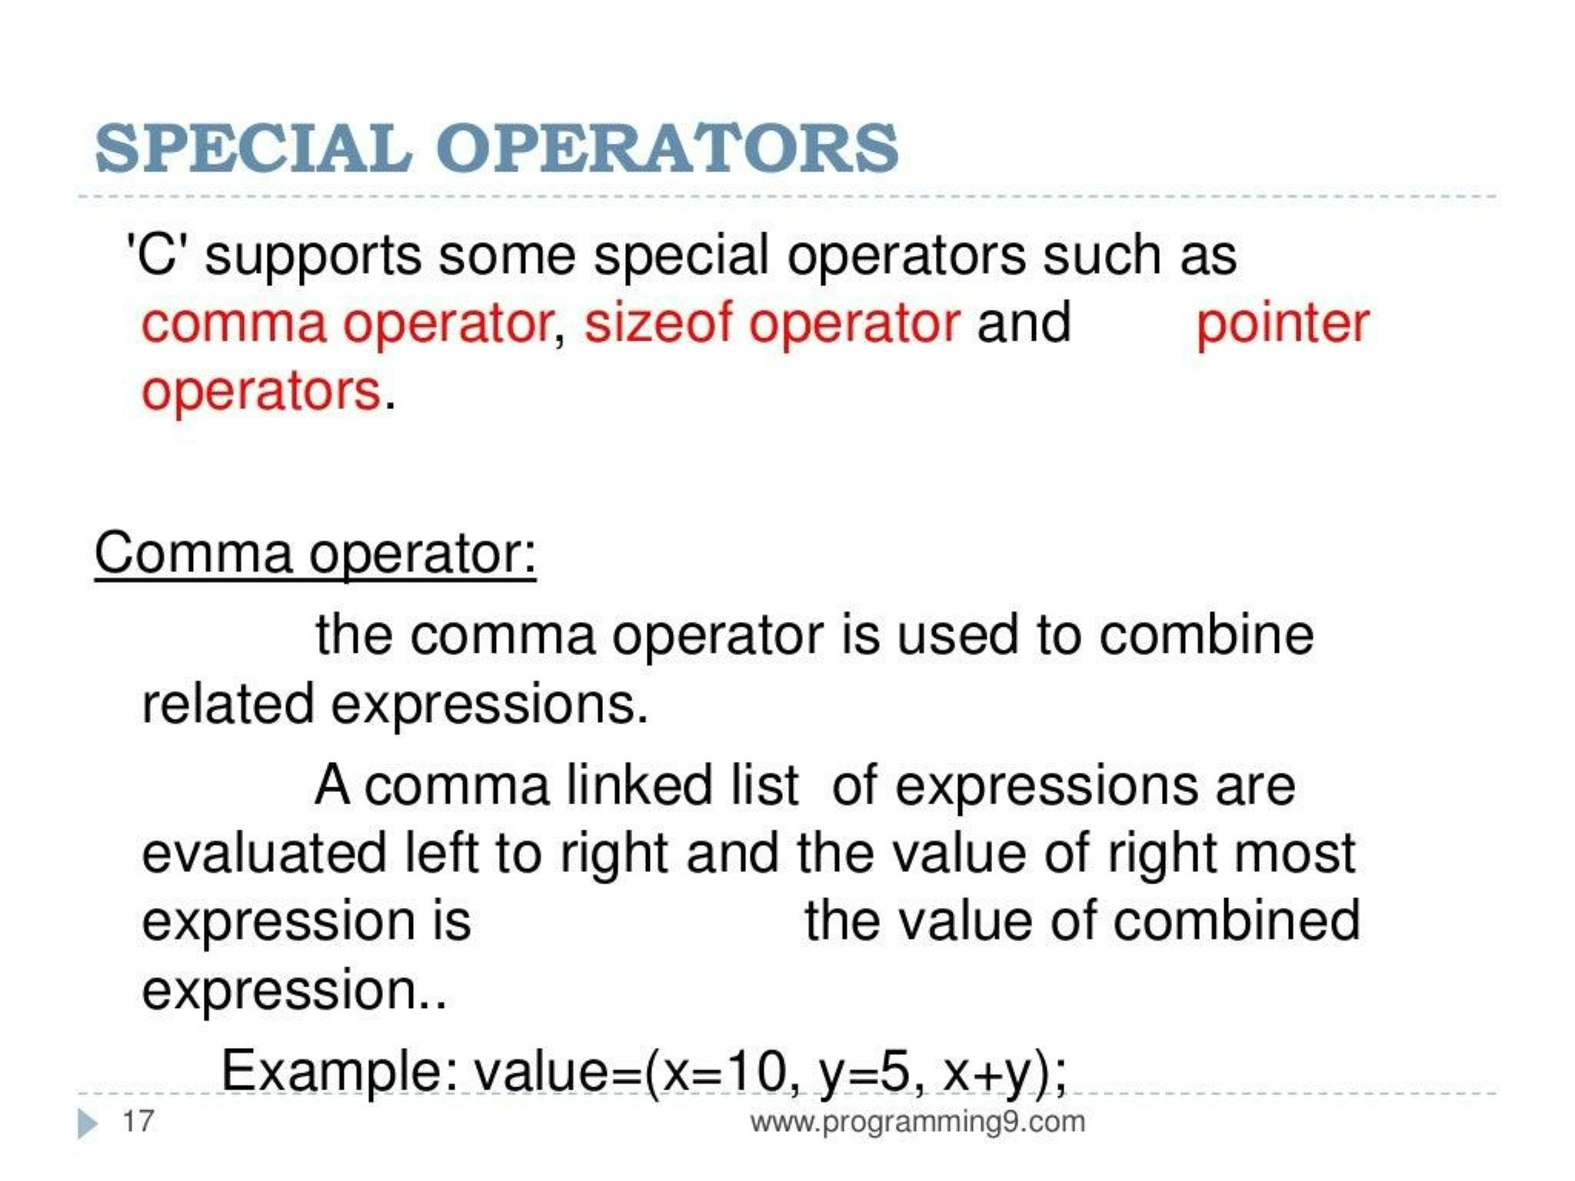

Slide 18
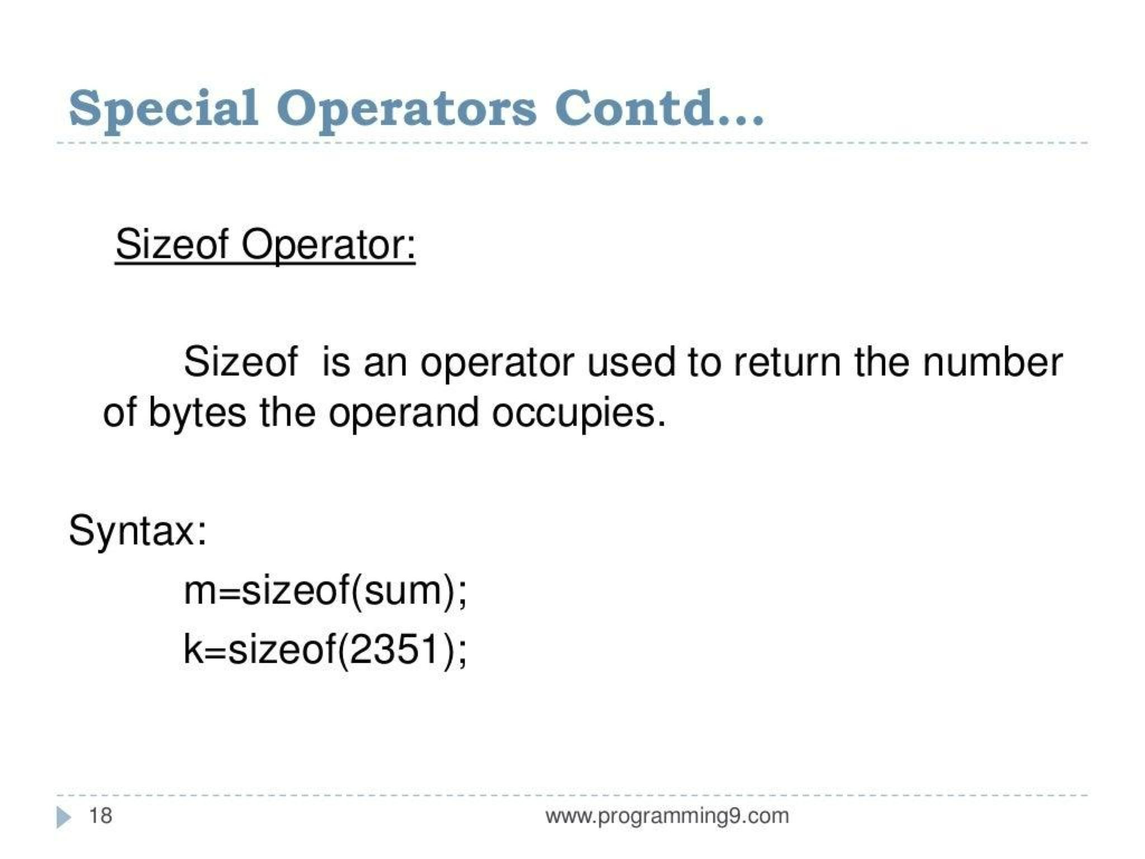

Slide 19
Type Conversion in Expressions
Type conversion refers to changing one data type to another in a program. This can occur explicitly or implicitly:
Implicit Type Conversion (Automatic Type Conversion):
Performed automatically by the compiler when different data types are used together in an expression.
Example:
int a = 5;
float b = 3.2;
float result = a + b; // 'a' is implicitly converted to float
Here, the integer a is implicitly converted to a float to match the type of b, ensuring the expression can be evaluated correctly.

Slide 20
2. Explicit Type Conversion (Type Casting):
Done manually by the programmer using a cast operator.
Syntax: (type) expression
Example:
float a = 5.5;
int b = (int) a; // 'a' is explicitly converted to int
Here, the float a is explicitly cast to an integer, truncating the decimal part.

Slide 21
Operator Precedence and Associativity
Operator precedence determines the order in which operators are evaluated in expressions with more than one operator.
Precedence:
Operators with higher precedence are evaluated before operators with lower precedence.
Example:
int result = 3 + 5 * 2; // Multiplication (*) has higher precedence than addition (+)
In this example, 5 * 2 is evaluated first, then the result is added to 3.

Slide 22
Associativity:
When operators of the same precedence appear in an expression, associativity determines the order of evaluation.
Most operators have left-to-right associativity (evaluated from left to right), but some like the assignment operator = have right-to-left associativity.
Example:
int result = 5 - 3 + 2; // Both - and + have the same precedence and left-to-right associativity
Here, 5 - 3 is evaluated first, followed by the addition of 2.

Slide 23
Precedence and Associativity Table (Common Operators)
Operator | Description | Associativity
() | Parentheses | Left-to-right
*, /, % | Multiplication, Division, Modulus | Left-to-right
+, - | Addition, Subtraction | Left-to-right
=, +=, -= | Assignment Operators | Right-to-left

